Slide 1
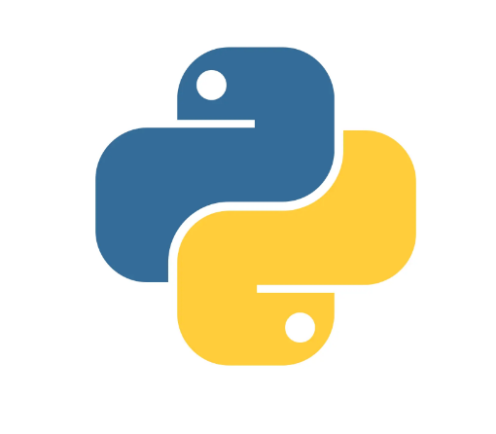
Python Programming
Presented By
Subhashree Sahoo

Slide 2

Introduction to Python
Python is a general purpose, high level, Interpreted and dynamic programming languages.
Created by Guido Van Rossum 1989
Named after Monty Python

Slide 3
Python Features
Easy to learn and use
Expressive language
Interpreted language
Free and Open source – https://www.python.org/
Large standard library
Object oriented language
Extensible
GUI Programming support

Slide 4
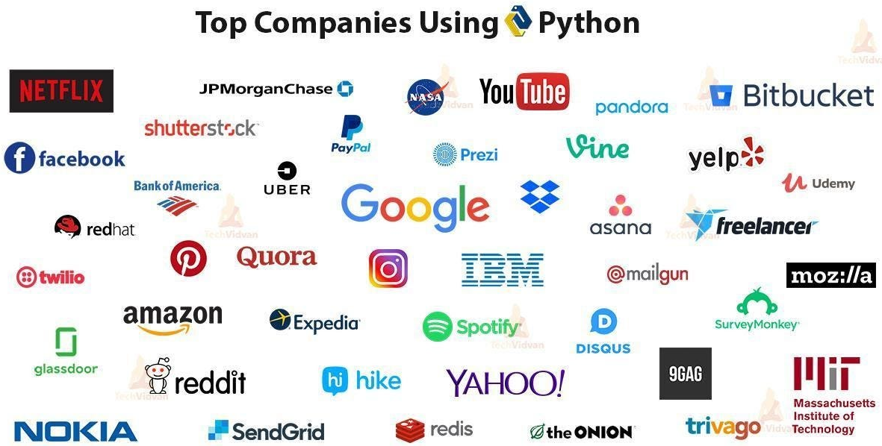
Image ref: https://medium.com/nerd-for-tech/top-10-python-development-company-to-hire-d83507a33755

Slide 5
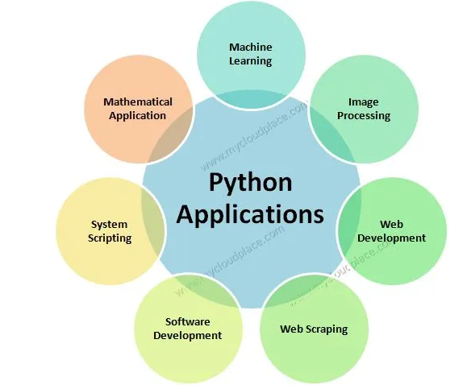
Application of Python
Image ref: https://mycloudplace.com/python-programming-introduction/

Slide 6
Installation of Python
There are many interpreters available freely to run Python scripts like IDLE (Integrated Development Environment) which is installed when you install the python software from http://python.org/downloads/
Steps to be followed and remembered:
Step 1: Select Version of Python to Install.
Step 2: Download Python Executable Installer.
Step 3: Run Executable Installer.
Step 4: Verify Python Was Installed On Windows.
Step 5: Verify Pip Was Installed.
Step 6: Add Python Path to Environment Variables (Optional)

Slide 7
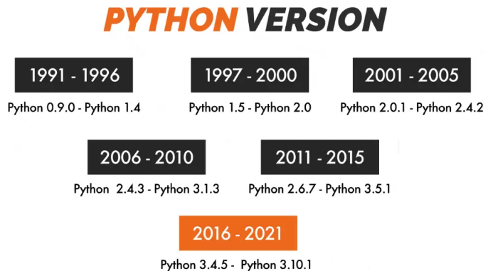
Installation of Python
For Windows
Download python from – https://www.python.org/
For Linux
Python is already install on Linux when operating system is getting installed
Image ref: https://www.optimalvirtualemployee.com/blog/python-programming-language-for-advanced-users/

Slide 8
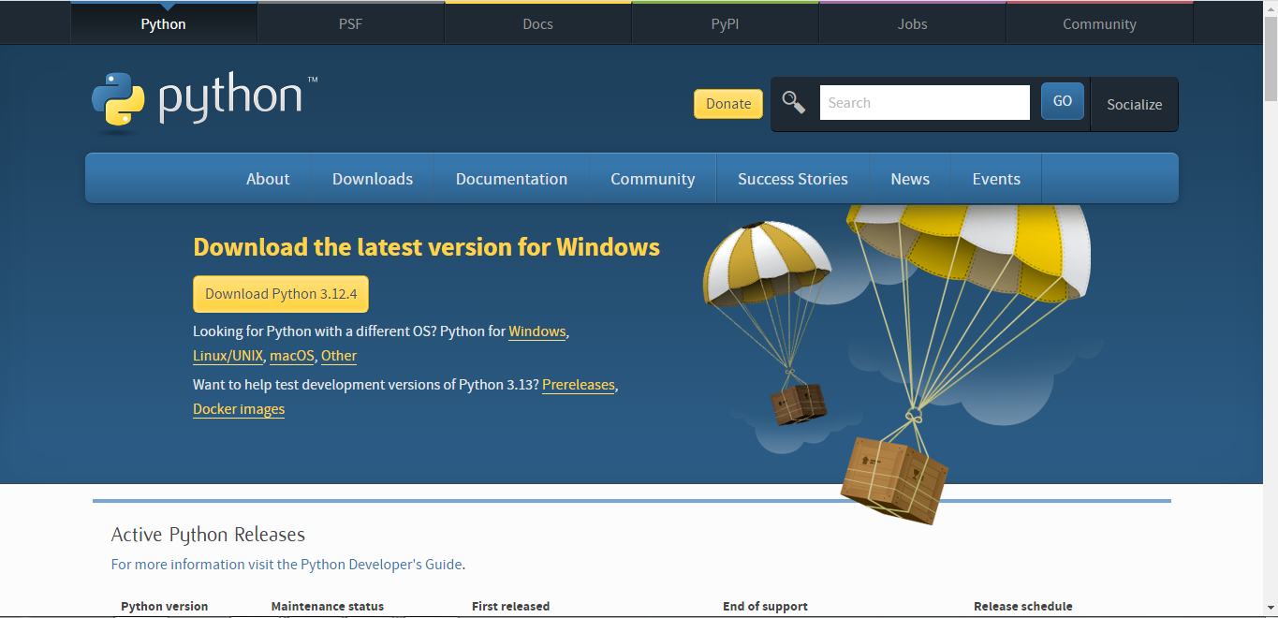
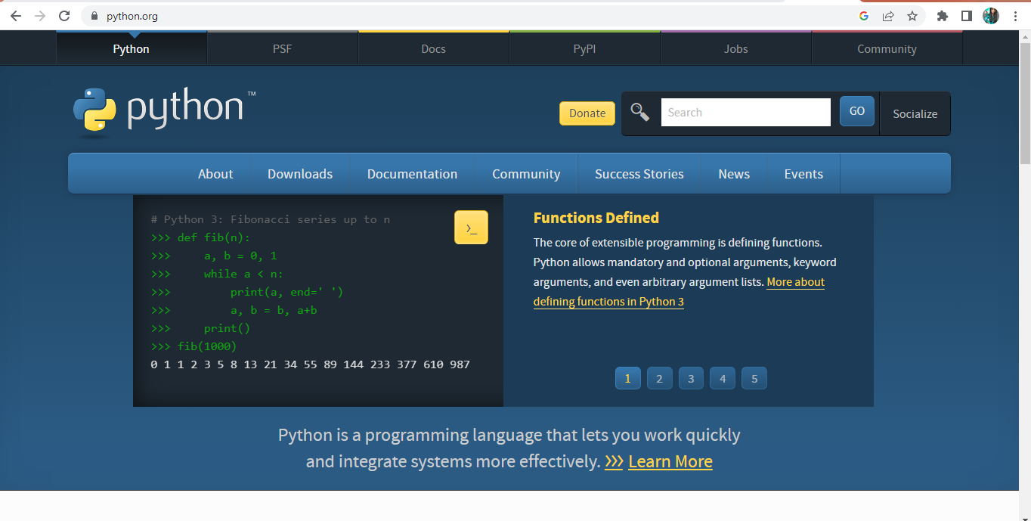

Slide 9


Slide 10
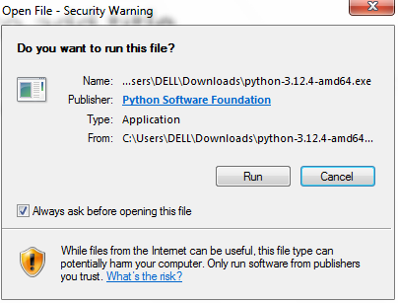
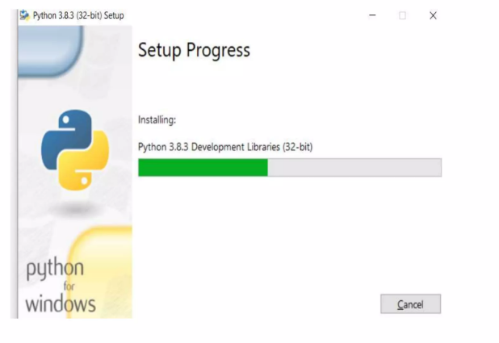

Slide 11
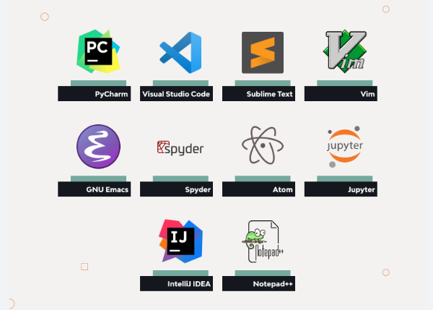
Free IDES to run Python

Slide 12
Data
Dictionary defines data in 3 aspects:
Factual information (such as measurements or statistics) used as a basis for reasoning, discussion, or calculation
Information in digital form that can be transmitted or processed
Information output by a sensing device or organ that includes both useful and irrelevant or redundant information and must be processed to be meaningful.

Slide 13
Information
Then below is how information is defined in the same dictionary:
Knowledge obtained from investigation, study, or instruction
A signal or character (as in a communication system or computer) representing data
Something (such as a message, experimental data, or a picture) which justifies the change in a construct (such as a pen or theory) that represents physical or mental experience or another construct
A quantitative measure of the content of information
The communication or reception of knowledge or intelligence.

Slide 14
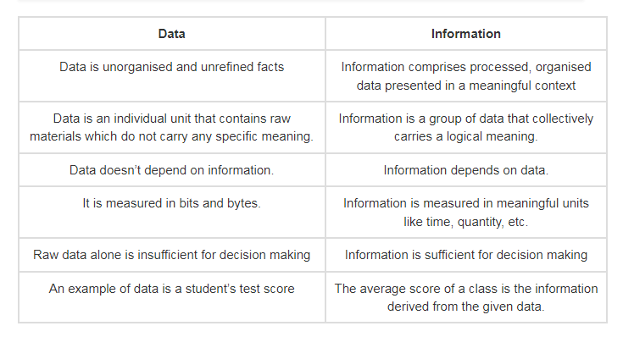
Data Vs Information

Slide 15
Variables
Binding between a name and an Object.
Single variable assignment x=1
Multi variable assignment x,y= 1,2
Swap values x,y = y,x
#This is a comment , Comments usually starts with # symbol.

Slide 16
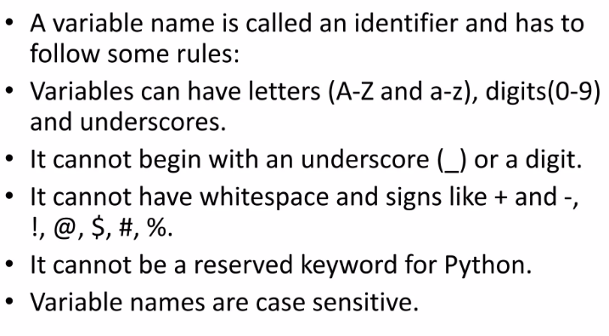
Identifiers

Slide 17
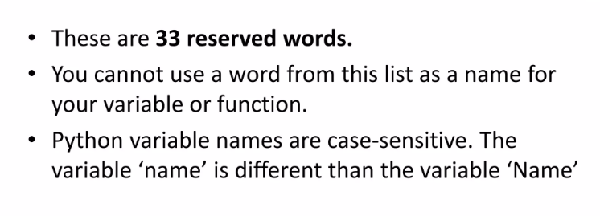
Reserved Keywords

Slide 18
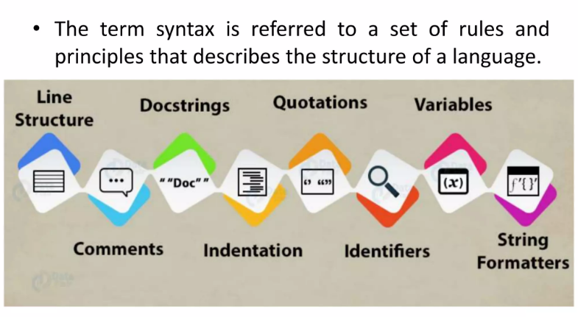
Python Syntax

Slide 19
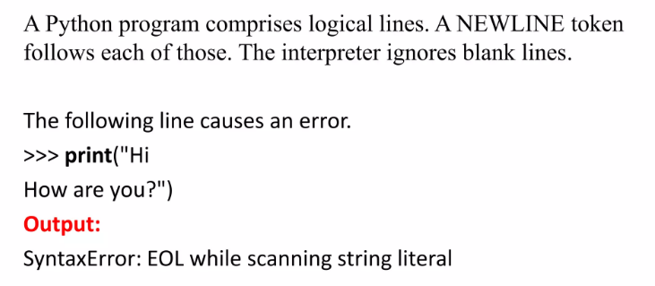
Python Line Structure

Slide 20
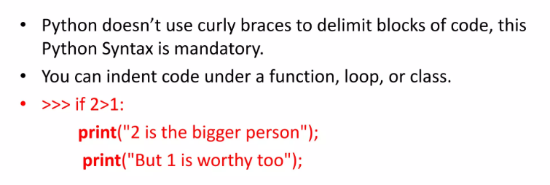
Python Indentation

Slide 21
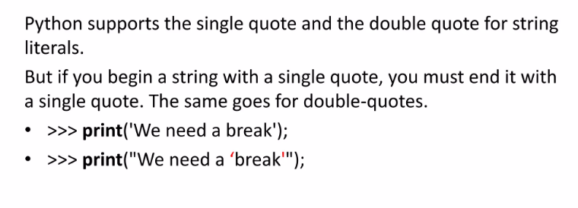
Python Quotations

Slide 22
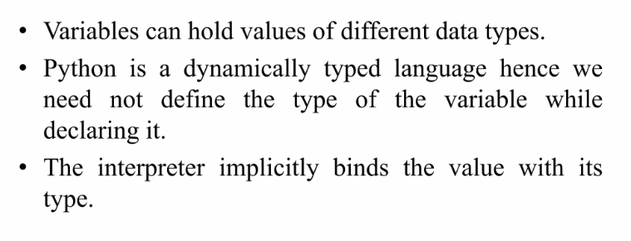
Data Types

Slide 23
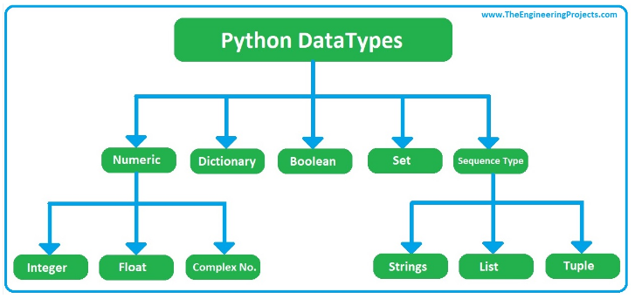
Data Types in Python
Image ref: https://www.theengineeringprojects.com/2020/06/how-to-use-data-types-in-python.html

Slide 24
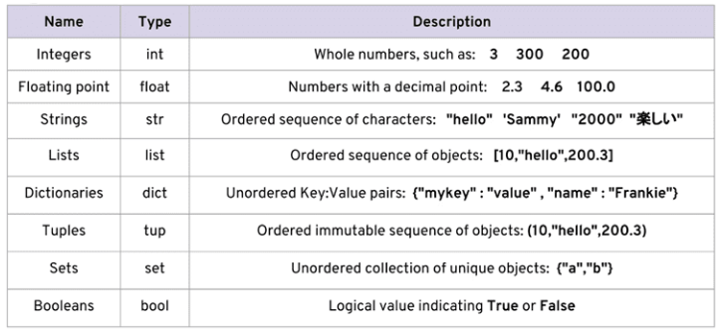
Data Types in Python
Image ref: https://itsengg.edu.in/blogs/post/data-types-in-python-numeric-data-type

Slide 25
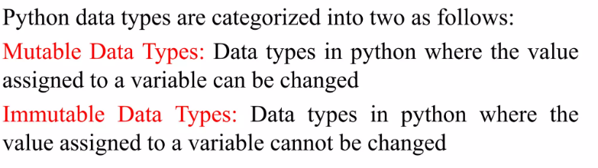
Data Types in Python

Slide 26
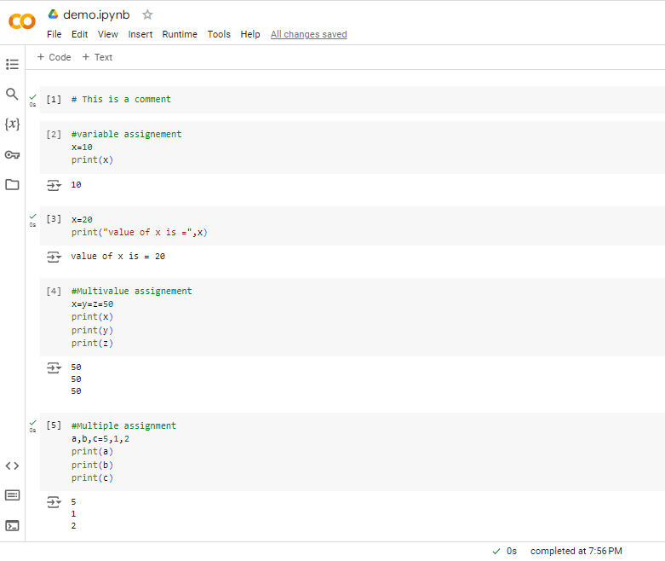

Slide 27
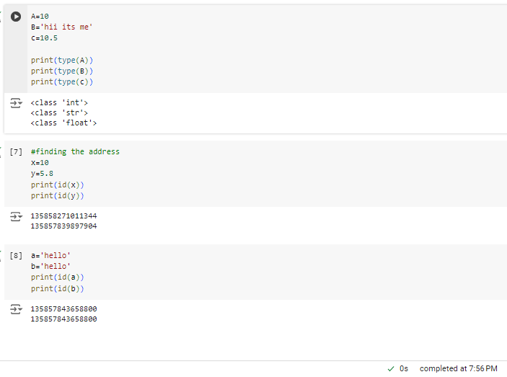

Slide 28
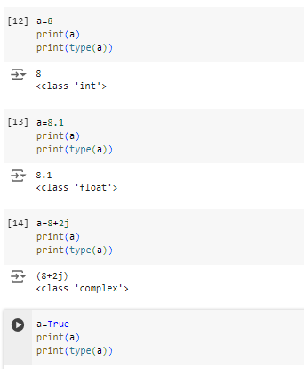

Slide 29
Python Operators
The operator is a symbol that performs a specific operation between two operands, according to one definition. Operators serve as the foundation upon which logic is constructed in a program in a particular programming language.
Arithmetic operators
Comparison operators
Assignment Operators
Logical Operators
Bitwise Operators
Membership Operators
Identity Operators
Arithmetic Operators

Slide 30
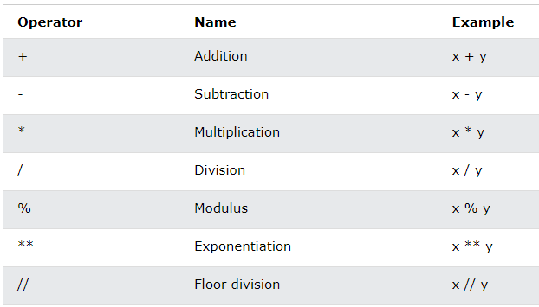
Arithmetic Operator

Slide 31
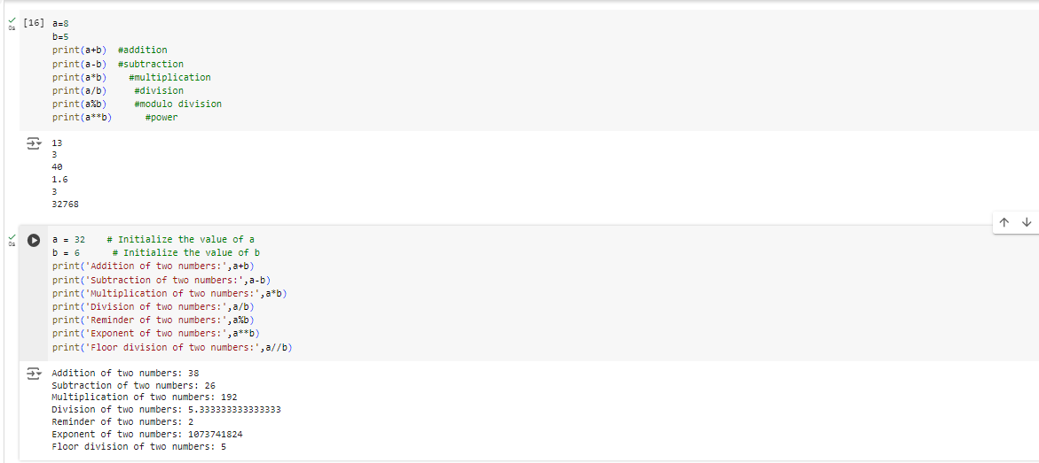

Slide 32
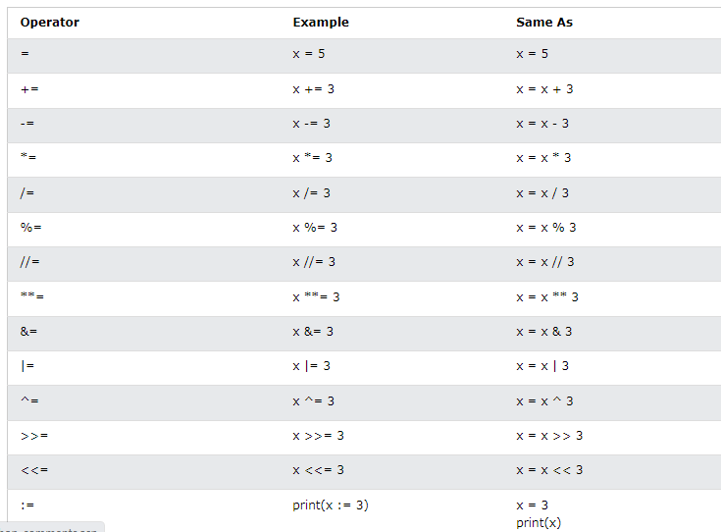
Assignment Operator

Slide 33
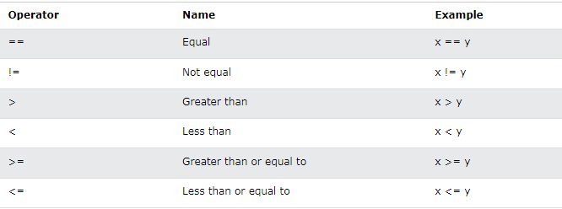
Comparison Operator

Slide 34
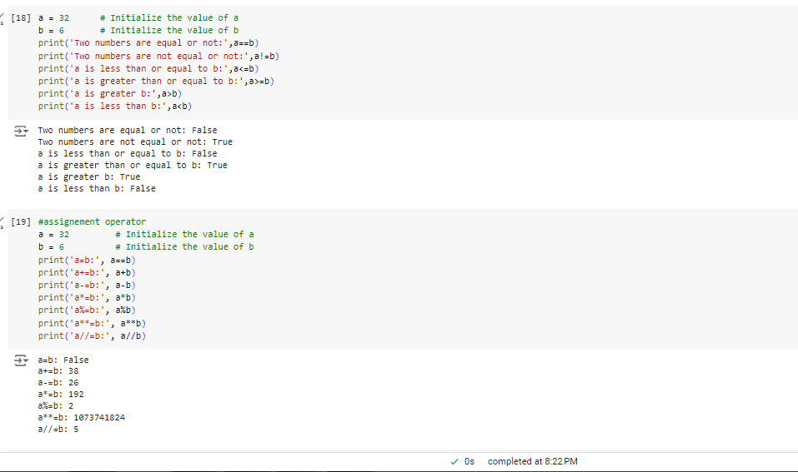

Slide 35
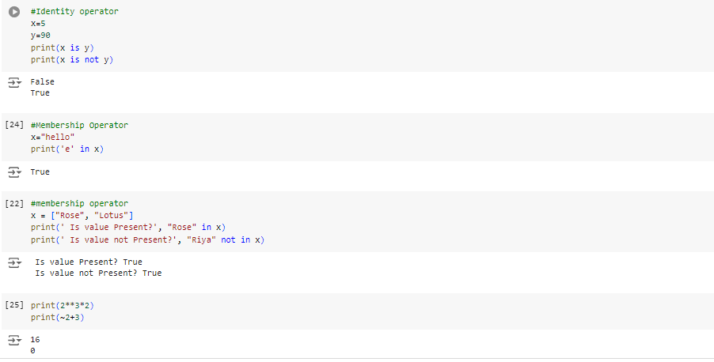

Slide 36
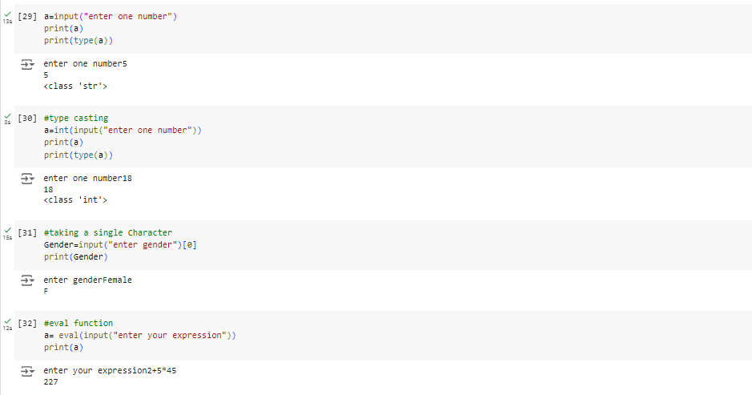

Slide 37
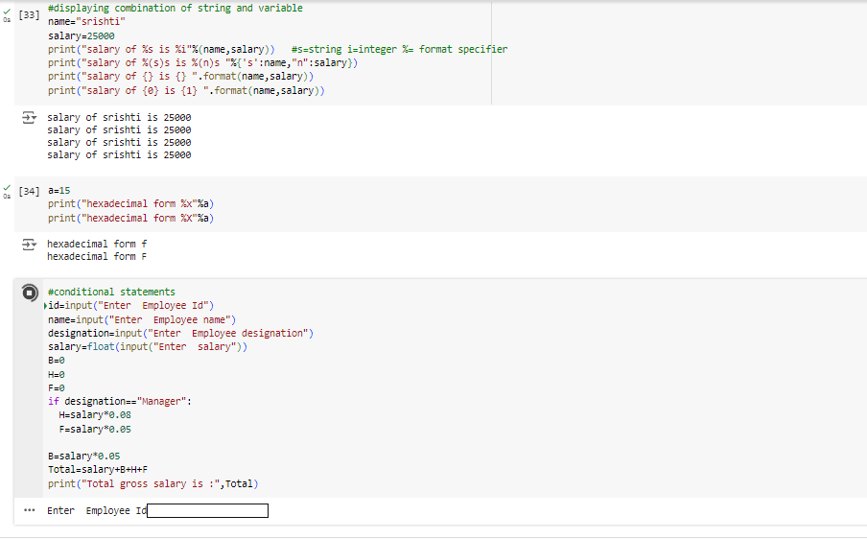

Slide 38
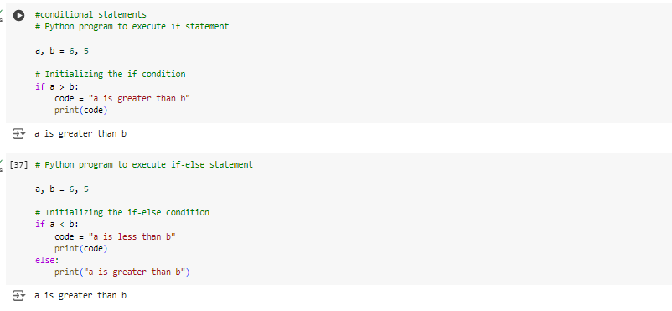
Conditional expressions
Python's conditional statements carry out various calculations or operations according to whether a particular Boolean condition is evaluated as true or false. In Python, IF statements deal with conditional statements.
Syntax
if <conditional expression>
Statement
else
Statement

Slide 39
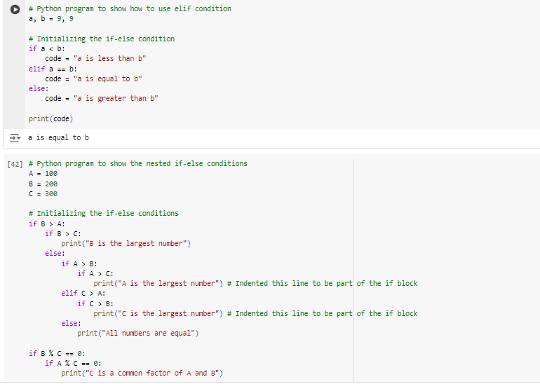

Slide 40
Loops in Python
Python offers 3 choices for running the loops. The basic functionality of all the techniques is the same, although the syntax and the amount of time required for checking the condition differ.
For loop
This type of loop executes a code block multiple times and abbreviates the code that manages the loop variable.
While loop
Repeats a statement or group of statements while a given condition is TRUE. It tests the condition before executing the loop body.
Nested Loop
We can iterate a loop inside another loop.

Slide 41
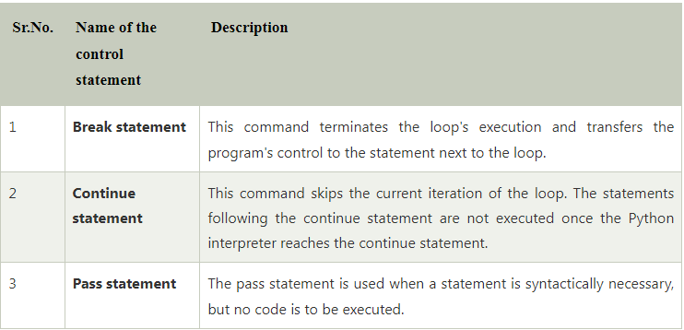
Loop Control statements

Slide 42
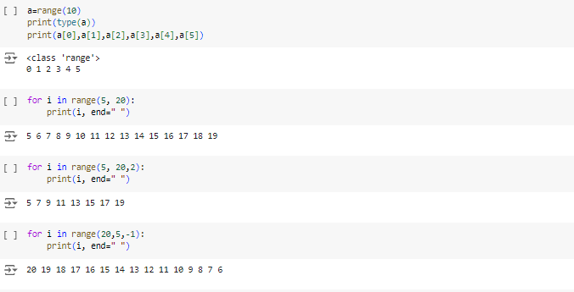
For Loop
Syntax
for value in sequence:
{ code block }

Slide 43
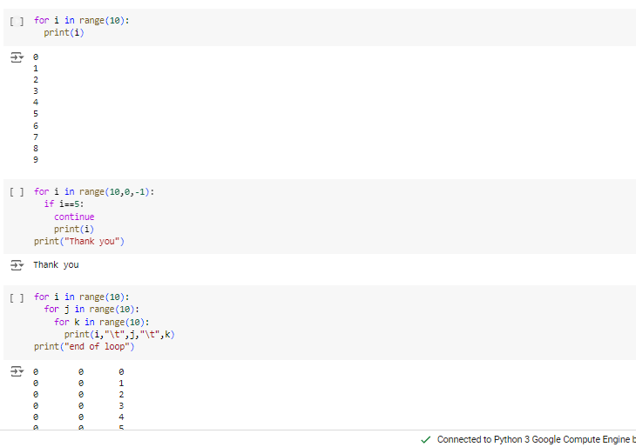

Slide 44
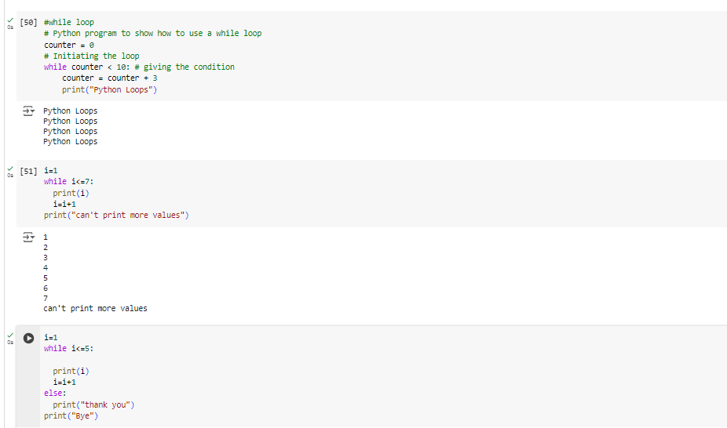
While Loop
Syntax-
while <condition>:
{ code block }

Slide 45
Function
A collection of related assertions that carry out a mathematical, analytical, or evaluative operation is known as a function.
The objective is to define a function and group-specific frequently performed actions. Instead of repeatedly creating the same code block for various input variables, we can call the function and reuse the code it contains with different variables.
Syntax:
# An example Python Function
def function_name( parameters ):
# code block

Slide 46
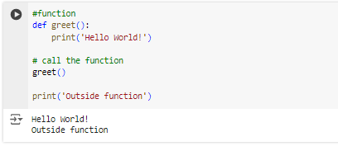
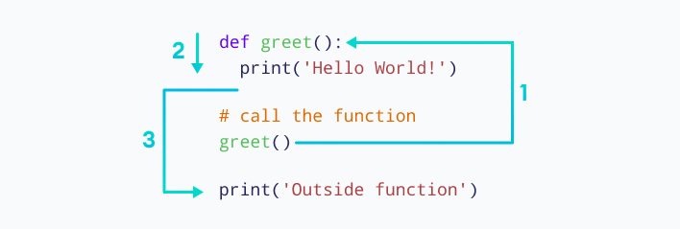
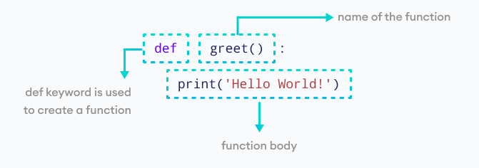

Slide 47
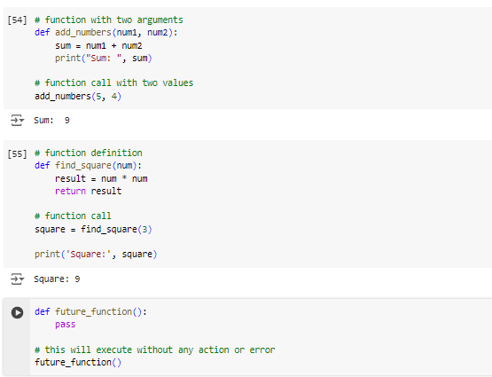

Slide 48
Libraries in Python
Each of Python's open-source libraries has its own source code. A collection of code scripts that can be used iteratively to save time is known as a library.
A collection of modules that are linked together is also known as a Python library. It has code bundles that can be used again and again in different programs.
Some of these libraries are
Numpy
Pandas
Matplotlib

Slide 49
Numpy
The name “Numpy” stands for “Numerical Python”.
NumPy focuses on scientific and mathematical computation. It makes it easy to work with large matrices and multidimensional data thanks to built-in mathematical functions that make it easy to compute.
NumPy is preferred over lists in Python because it uses less memory, is faster, and is easier to use.

Slide 50
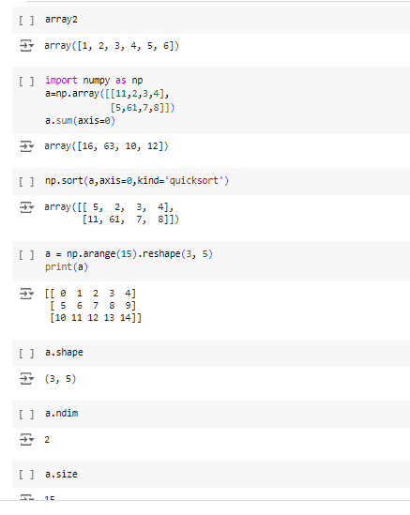
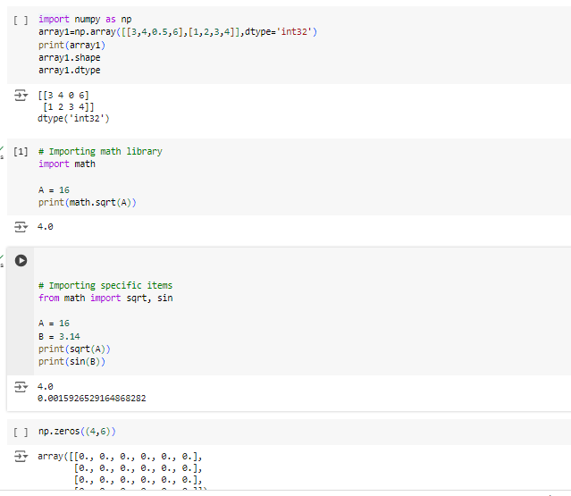

Slide 51
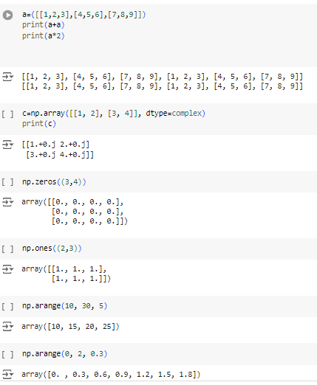
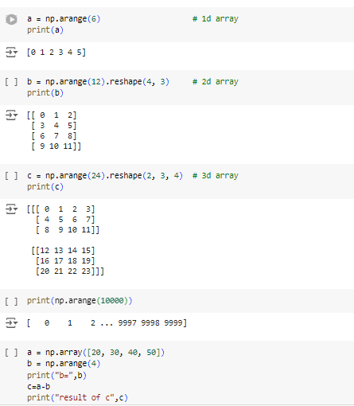

Slide 52
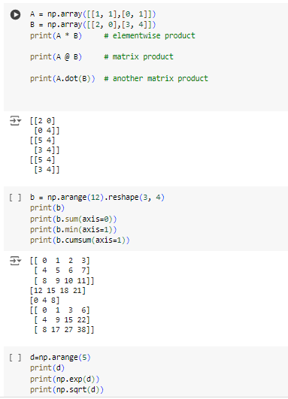

Slide 53
Pandas
Pandas are an important library for data scientists. It is an open-source machine learning library that provides flexible high-level data structures and a variety of analysis tools. It eases data analysis, data manipulation, and cleaning of data. Pandas support operations like Sorting, Re-indexing, Iteration, Concatenation, Conversion of data, Visualizations, Aggregations, etc.

Slide 54
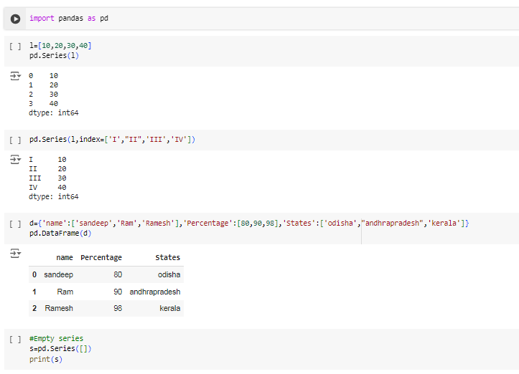
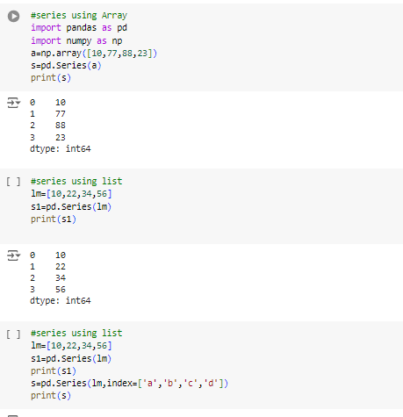

Slide 55
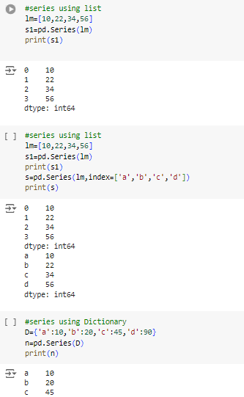
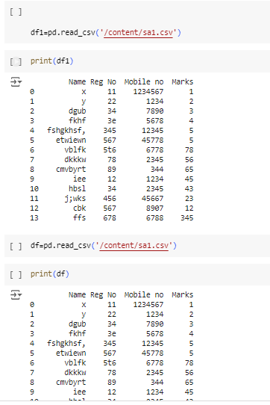

Slide 56

Matplotlib
This library is responsible for the plotting of numerical data. It is utilized in data analysis for this reason. An open-source library plots superior quality figures, for example, pie outlines, scatterplots, boxplots, and diagrams, in addition to other things.

Slide 57



Slide 58



Slide 59




Slide 60



Slide 61



Slide 62

Python in computer vision
Python is widely used programming languages for processing the Digital Images.
A digital image is representation of real image as a set of numbers that can be stored and handled by a digital computer.
In order to translate the image into numbers it is divided into small areas called pixels.

Slide 63


Slide 64


Slide 65


